Slide 1
OGCancerNI – Oesophageal
& Stomach Cancer Support

Slide 2
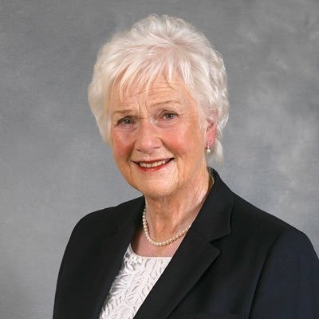
Introduction
Helen Setterfield
Chair of OGCancerNI
Past Patient – 14 years post surgery
Passionate about improving patient outcomes

Slide 3
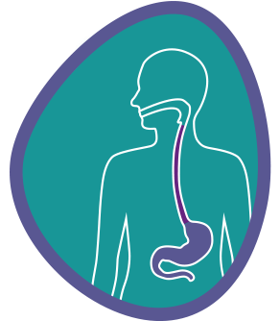
Who Are We?
Charity formed specifically to…
benefit patients and families affected by Oesophago-gastric cancer. We are currently waiting to be called forward to the Charity Commission NI.

Slide 4
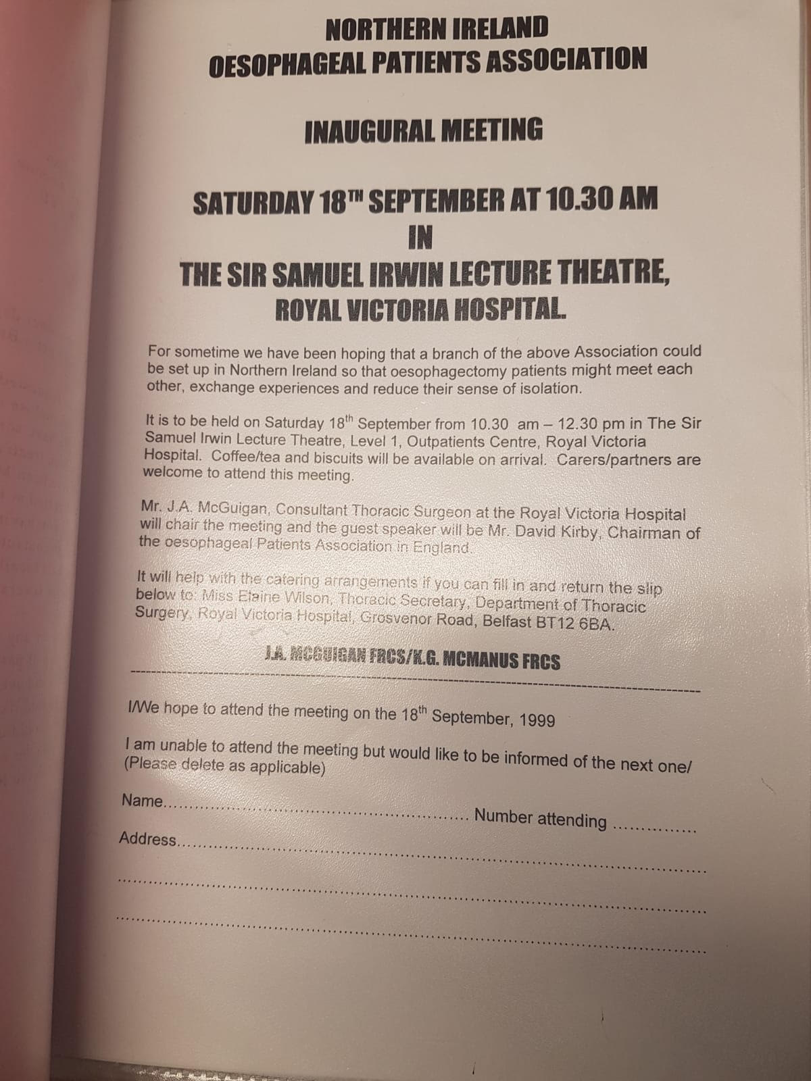
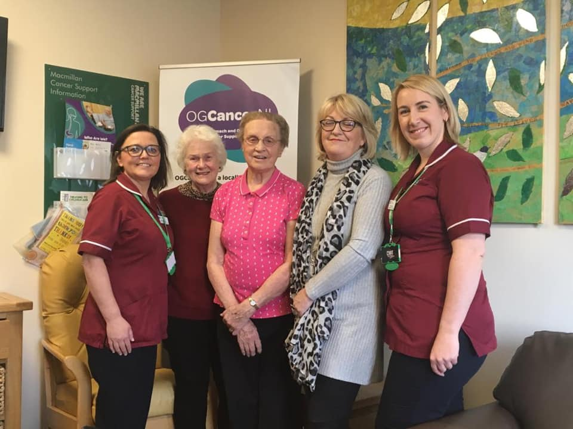
Where It All Began
Roy McMullan founded an Oesophageal Cancer Patient Association in September 1999. This support group grew and grew and in 2018, we launched as a standalone charity in Northern Ireland after the committee and volunteers recognised the benefit in creating a separate Northern Ireland charity to maximise support locally.

Slide 5
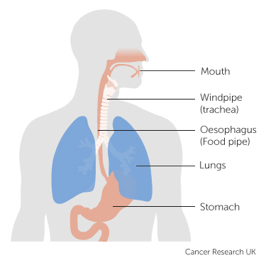
What is Oesophago-Gastric Cancer?
Oesophageal cancer is cancer of the gullet and gastric cancer is cancer of the stomach.
Combined, they are medically known as oesophago-gastric (OG) cancer.
The oesophagus (more commonly known as the gullet or food pipe) is the long tube that carries food from the throat to the stomach.
In Northern Ireland in 2016, a total of 226 people were diagnosed with oesophageal (gullet) cancer.
In the same year, 214 people were newly diagnosed with gastric (stomach) cancer

Slide 6
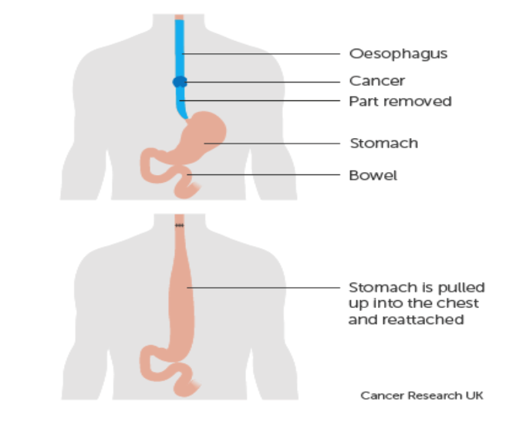
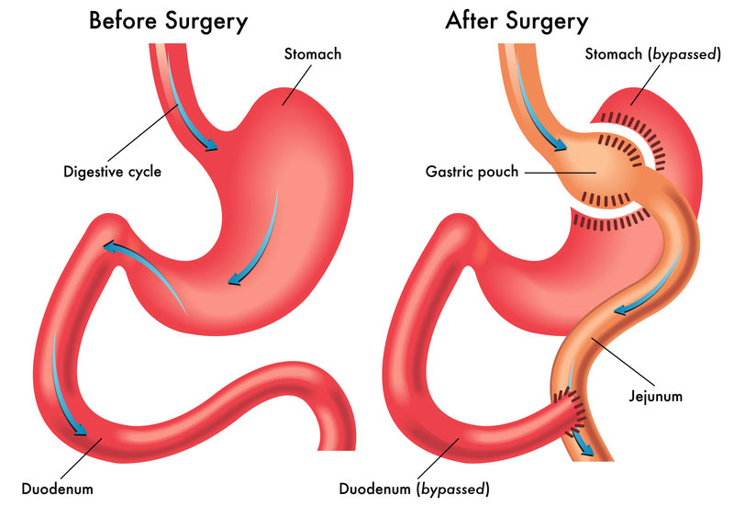
Oesophagectomy / Gastrectomy
An oesophagectomy or gastrectomy are the main potentially curative treatments for oesophago-gastric cancer. During the procedure, the surgeon removes the section of the oesophagus that contains the tumour and, if necessary, the nearby lymph nodes.
Adjusting to the “new normal” can be incredibly difficult after an oesophagectomy or gastrectomy.

Slide 7
Why do we do what we do?
Upper GI Cancer
Over 400 diagnoses
per year
226 oesophageal cancer; 189 gastric cancer
Late Diagnosis
only 8.7% of Upper GI cancer patients in Northern Ireland are diagnosed in the earliest stage of the disease.
Earlier Intervention
can improve outcomes and survivorship which can lead to improved symptom control, reduced distress, and better quality of life (Bauman & Temel, 2014).
^{Poor Survival Rates}
83% of patients diagnosed at a late stage will die within five years
(NI Cancer Registry, 2017).

Slide 8
Our Main Objectives
Supporting Patients
and carers who have been affected by Oesophago-Gastric Cancer
Raising Awareness
Fundraising
by communicating the early signs and symptoms of Oesophago-Gastric cancer to promote early intervention
to support research, projects and equipment that will improve patient outcomes

Slide 9
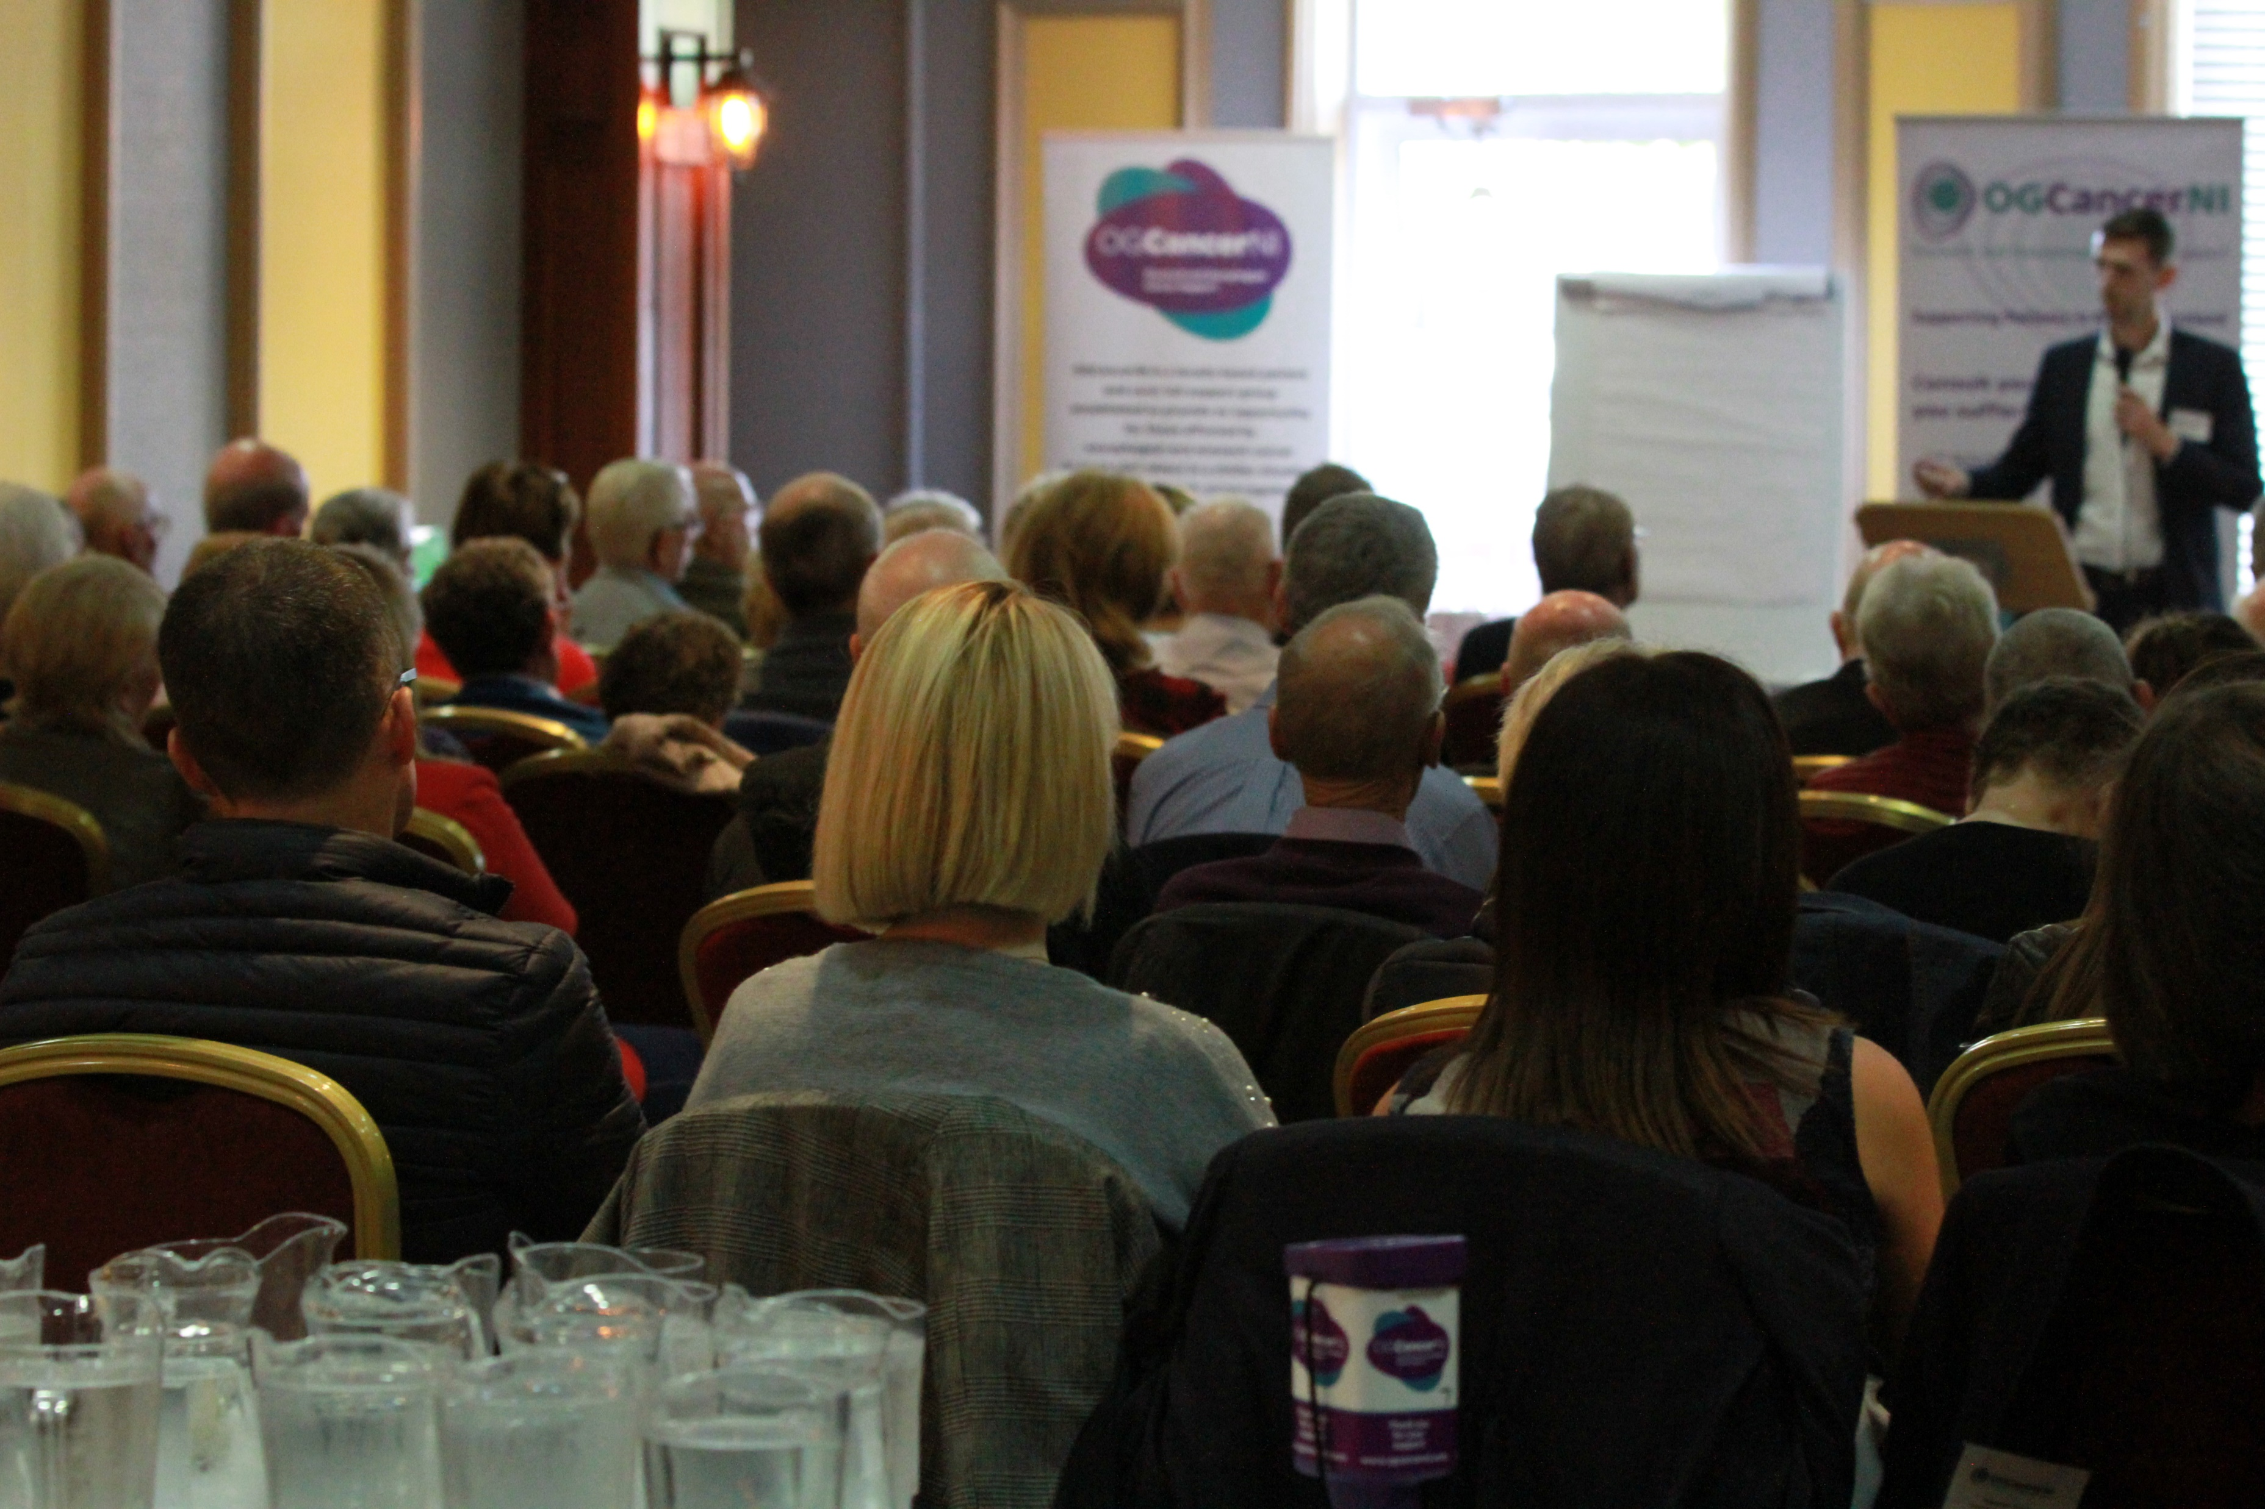
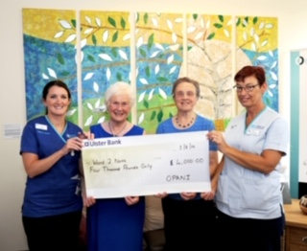
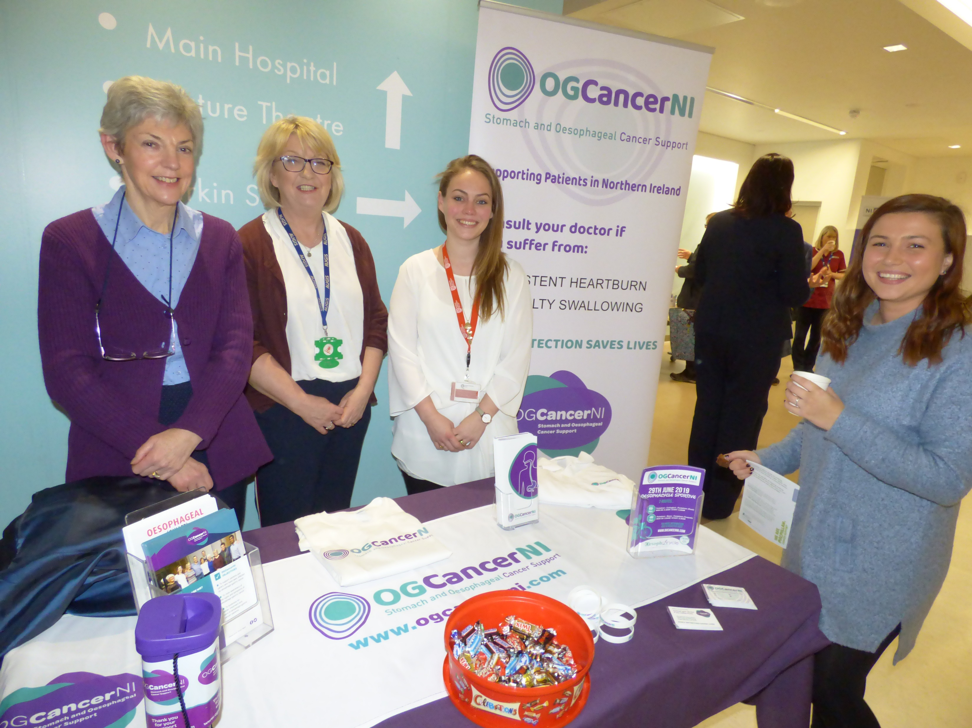
Objective 1 - Supporting Patients
1
2
3
Wellbeing Meetings
The Quiet Room
Information Stands
4
5
Small Group Meetings
One to One Support

Slide 10
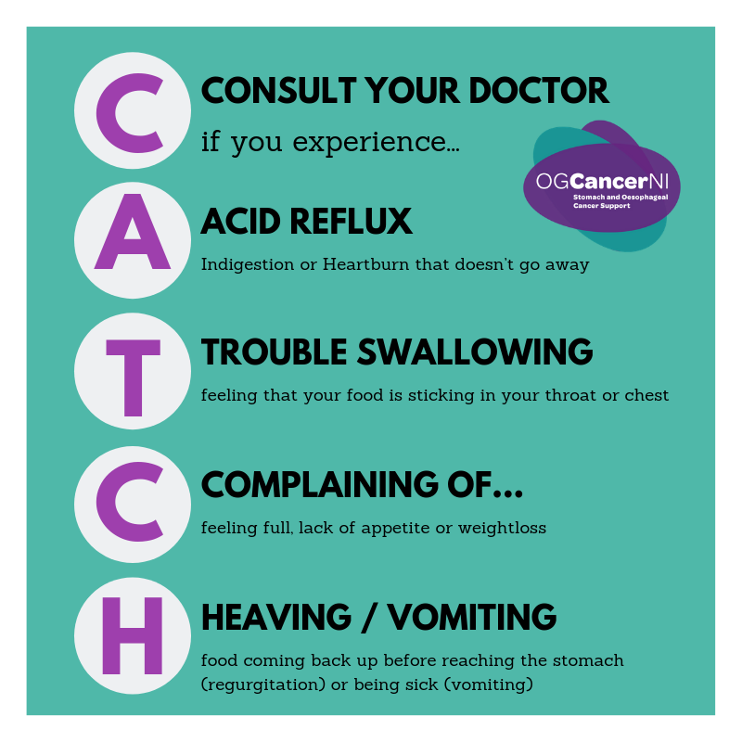
Objective 2 – Raising Awareness
One of the main problems we face is lack of awareness and understanding of oesophago-gastric cancer. Many people struggle with the pronunciation, spelling and even the ability to find the oesophagus in the body.
As a charity, one of our main objectives is to improve early diagnosis by raising public awareness of signs and/or symptoms of Oesophageal and Stomach cancer, and to encourage people to see their GP without delay.
“Catch It Early”
We will be launching our awareness campaign
“Catch It Early” in June 2019.

Slide 11
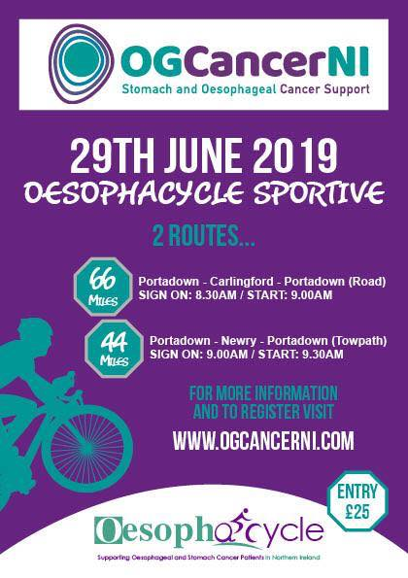
Upcoming Events

Slide 12
Upcoming Events

Slide 13
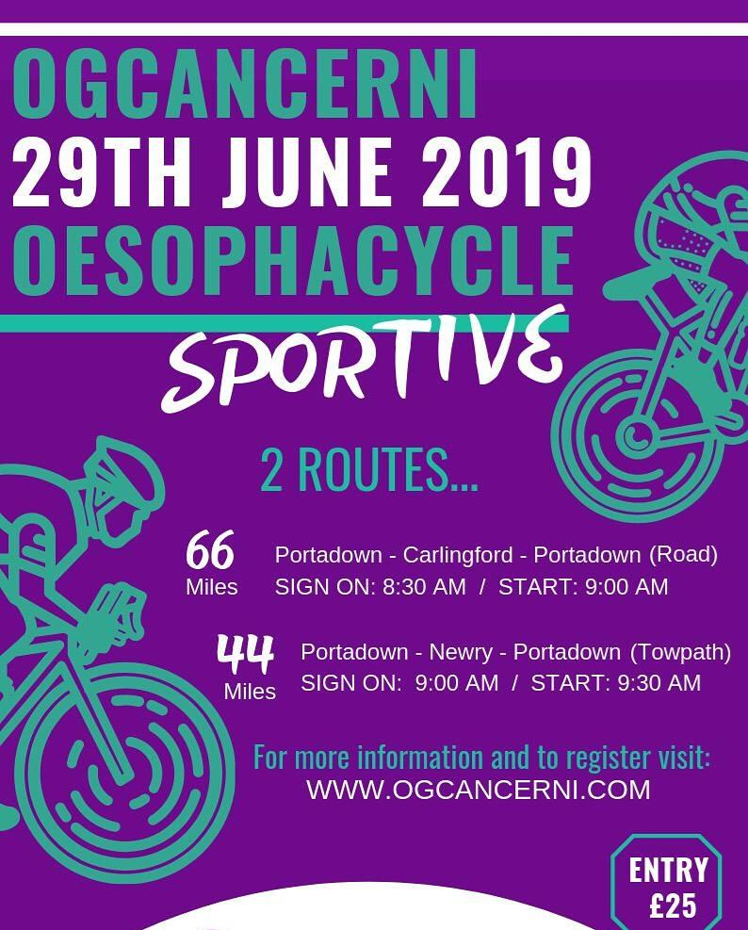
OESOPHACYCLE ‘19 will be held on 29 June 2019. Two routes will be available:
Portadown – Carlingford – Portadown (66 miles by road)
Portadown – Newry – Portadown (44 miles by towpath)
Professionally organised and supported this is an opportunity to view the beautiful NI landscape and raise some sponsorship funds to support our ‘Catch it Early’ awareness campaign launching in June 2019.
More details: ogcancerni.com/oesophacycle

Slide 14
The Oesophageal Run will take place on 16th June at Clotworthy House in Antrim. Whether you are just getting started on your running journey or are looking fora fast and fun event, we have the challenge to suit all levels.
Information is available on our website at www.ogcancerni.com

Slide 15
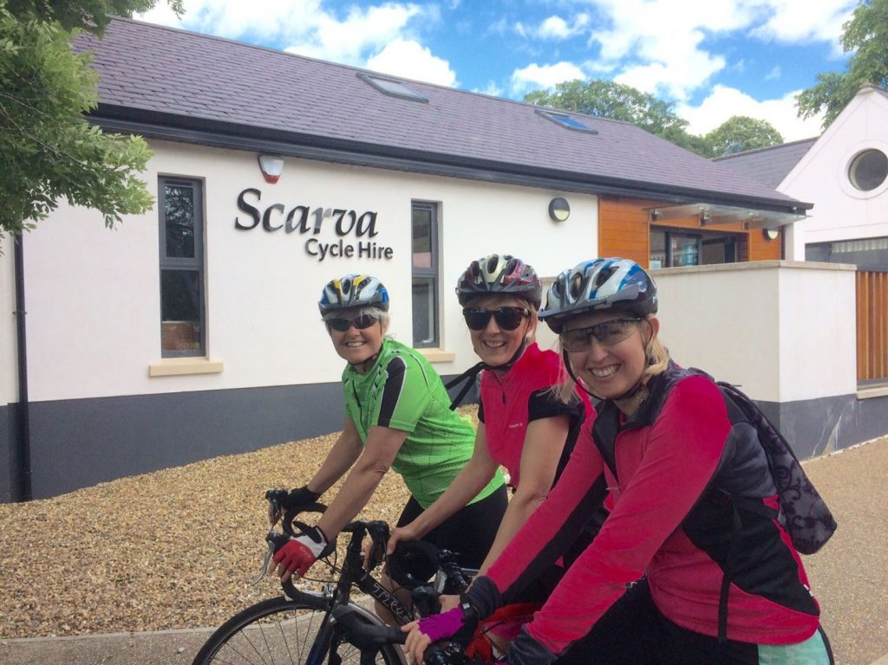
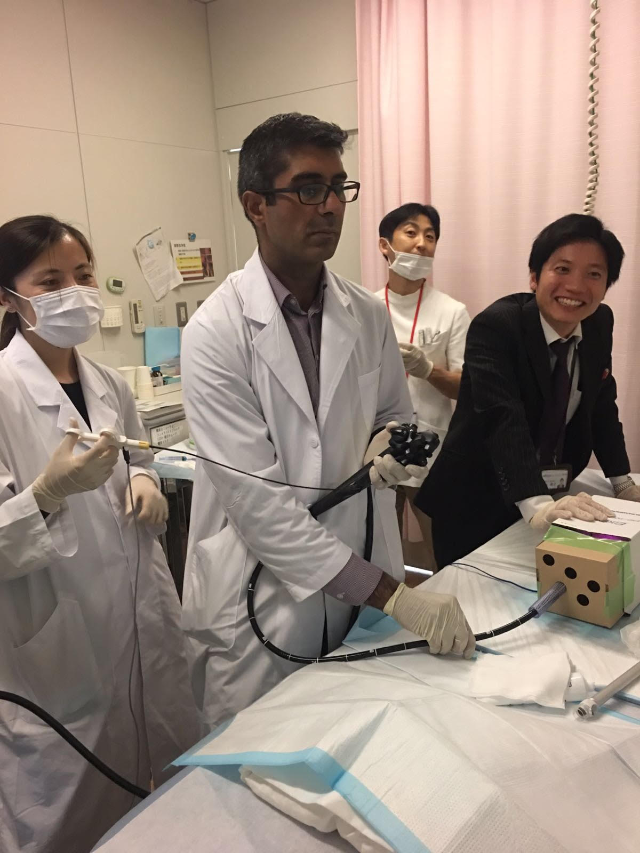
Objective 3 – Fundraising
State of the Art Surgical Procedures
We raised £40,000 for an item of specialist equipment which will revolutionise oesophago-gastric surgery in Northern Ireland.
Body Analysing Scales
These innovative scales measure body weight, body fat percentage, water percentage, muscle mass, bone mass, body mass index and energy consumption and will be available for OG Patients in the City Hospital.
Supporting Research
We work closely with a number of researchers at QUB who are investigating Oesophageal and Stomach Cancer here in Northern Ireland.

Slide 16
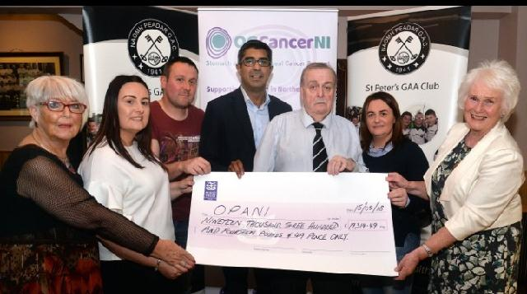
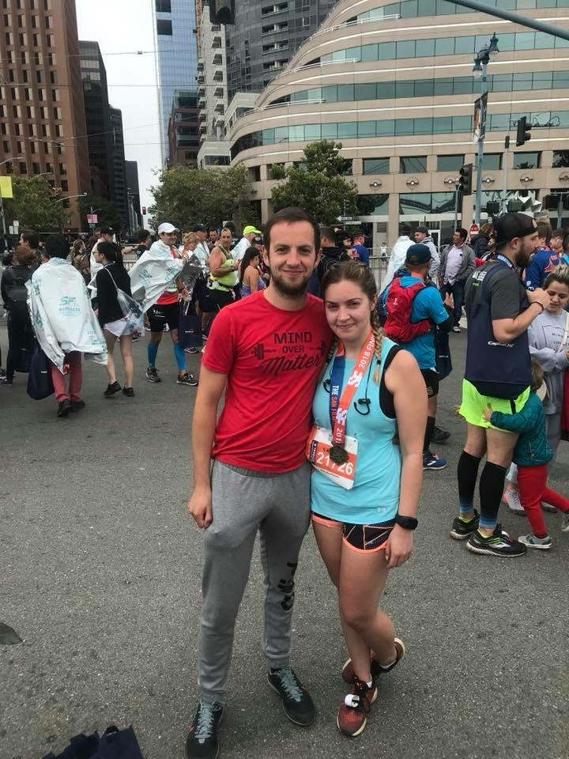
Fundraising

Slide 17
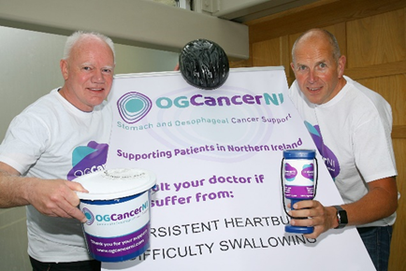
Volunteer
OGCancerNI is run by a dedicated and growing team of volunteers. If you’d like to help, here’s some things you can do:
Become a Volunteer by emailing info@ogcancerni.com or speaking to a volunteer or member of the committee
Like, share and comment on our social media pages on Twitter, Facebook and Instagram
Donate to our fundraising efforts

Slide 18
Volunteer
Purchase items from our store to help spread awareness – we have pens, wristbands, notepads, golf balls. Golf towels, beanies, t-shirts and pin badges for sale
Hold an event to raise funds – past events have included quiz nights, golf days, wedding favours, sponsored runs/walks/cycles and coffee mornings. We will help promote your event across our networks and can organise promotional material and support
Share our story: help us spread awareness by encouraging others to “Catch It Early”

Slide 19
Contact Us
www.facebook.com/ogcancerni
www.ogcancerni.com
www.twitter.com/ogcancerni
CCRCB, Lisburn Road, BT7 9AE

Slide 20
THANK
YOU
Questions?

