Slide 1
Families affected by cancer during the COVID-19 pandemic: the impact and need for support.
Dr Olinda Santin
Senior Lecturer
School of Nursing and Midwifery
Queen’s University Belfast
Email: o.santin@qub.ac.uk

Slide 2
My background
Psychology and Public Health
Supportive Cancer Care Research
Understanding the impact a diagnosis of cancer can have on families
Developing digital solutions- www.cancercaringcoping.com.

Slide 3
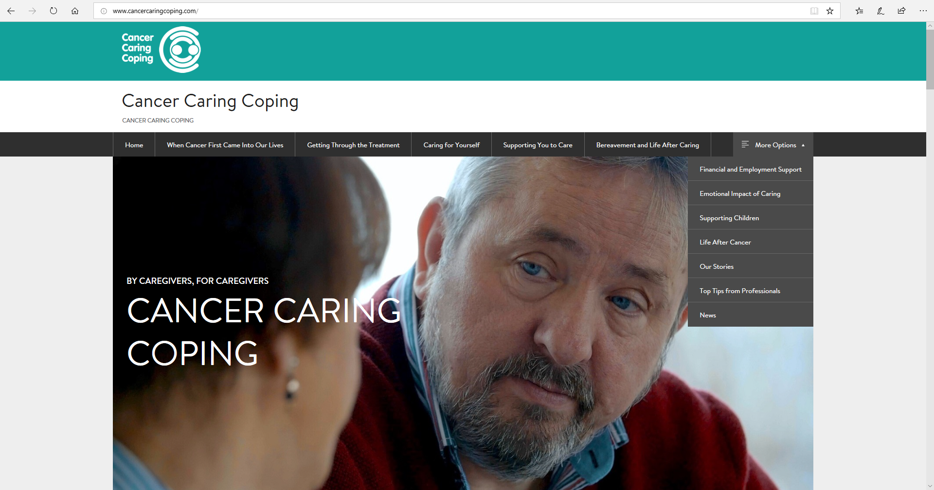

Slide 4
COVID-19 and cancer
A global pandemic announced on 11th March.
Measures introduced to suppress the spread of the virus.
Changes to normal health service with staff, beds and clinics reassigned.
Difficult decisions regarding COVID-19 exposure risk and the risk of cancer treatment delay.
Multiple hospital visits and immunosuppression meant that cancer patients were viewed to be particularly vulnerable to COVID-19 .

Slide 5
Aims
To understand the impact of COVID-19 on cancer patients and families during the pandemic.

Slide 6
Methods
18 years old patients with a diagnosis of cancer or person who provides informal care for any person currently diagnosed with cancer, at any stage of disease.
Promoted via multiple social media platforms online.

Slide 7
Methods
15 questions: EQ-5D-5L (EUROQOL), WHO-QoL-BREF (WHO, 1996).
13 closed questions explored carer caregiving duties, changes experienced during the pandemic, challenges faced and what support would be useful moving forward.
3 open ended questions regarding overall all experiences, difficulties and challenges and needs for support were also included.

Slide 8
Cancer patients
1,300 participants (n=6 oesophageal cancer)
Mainly female (73.1%), aged 51 years and older (71.8%), UK based (77.7%), married (74.1%), held a University degree (57.6%), retired/medically retired/unemployed (52.3%)
47% within 3 years of cancer diagnosis
17.5% lived alone
Only 3 people reported a COVID-19 diagnosis (at time of survey)
12.3% suspected they had COVID-19
63.6% were finding changes difficult to manage

Slide 9
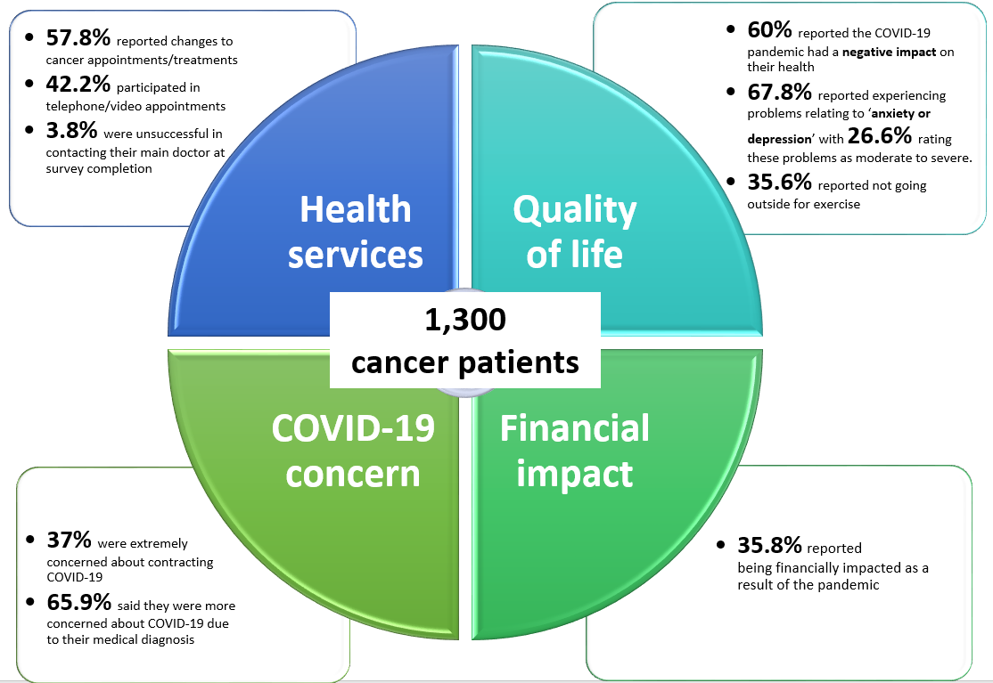

Slide 10
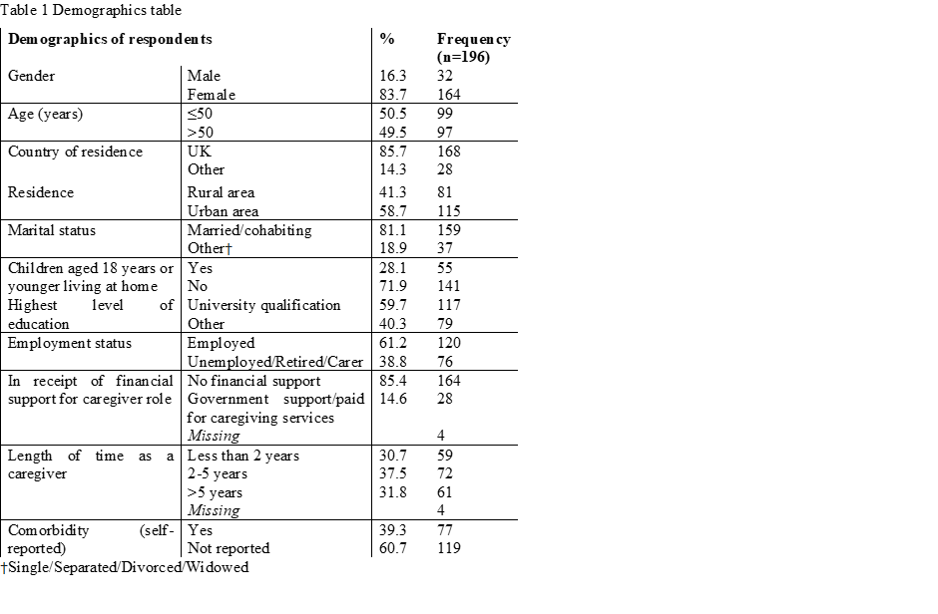
RESULTS

Slide 11
Psychological Impact
Intense fear that the person with cancer would contract the virus and die.
Continuous worry about survival.
Carers reported living in a state of hyper vigilance.
96.7% reported concern about passing on the virus and 43.4% reporting extreme concern about the virus.
Fear that the patient would be admitted to hospital.
Lack of contact with family and friends, reduced support.

Slide 12
Social impact
Social distancing restrictions greatly reduced support network.
Cancer carers reported feelings of loneliness and isolation.
The closure of recreational activities such as gyms, swimming pools and cafes removal of usual coping mechanisms.
Restrictions on society were viewed as ‘stealing time’ from families.

Slide 13
Finance Impact
Significant negative impact of COVID-19 on employment, working patterns and finances.
42.9% of carers reported financial burden .
Some carers reported a leave of absence from work in order to shield the patient.
Concern for those self-employed carers.
Working unsociable hours to keep up with the demands of their job and caring responsibilities.

Slide 14
Caregiver burden
Reduction of respite and supportive services.
Complexity in obtaining essential items such as groceries and medications.
Working from home and homeschooling children.
Carers with children and those in employment reported additional burden as they attempted to manage multiple tasks.

Slide 15
Impact on cancer and palliative services
59.6% (n=109) carers reported had not been affected.
24.6% (N=45) reported treatment delays and 15.8% (N=29) treatment was unavailable.
Service disruption in relation to delayed cancer appointments, tests and treatments.
Carers could not attend appointments and as consequence felt ill informed and worried.
A lack of communication and information from cancer services.
Reduced or withdrawal of supportive end of life services.

Slide 16
What carers need
Tailored information and communication regarding shielding, accessing support, keeping virus free and caring for someone with cancer.
Online support including networking and counselling.
Better communication.
Clear, consistent information and guidance specific to cancer.
Social interaction for cancer carers.
Achieving a balance of caring.
Emotional and financial support.

Slide 17
Conclusions
COVID-19 pandemic has had a negative impact on cancer carers.
The development of online support may be helpful.
There is a need to explore ways to provide palliative and supportive care at home in a safe way.
Urgent engagement with health and supportive care providers particularly primary care, cancer services and the voluntary sector is required in order to identify feasible solutions in currently strained services.

